Slide 1
Numerical Simulations for Characterization of Missing Articulatory Information in Ultrasound Imaging for Speech
Sarah R. Li,¹ Suzanne Boyce, PhD, CCC-SLP,²
& T. Douglas Mast, PhD¹
¹Biomedical Engineering; ²Communication Sciences and Disorders
University of Cincinnati
184th Acoustical Society of America Meeting | Chicago, IL | May 12, 2023

Slide 2
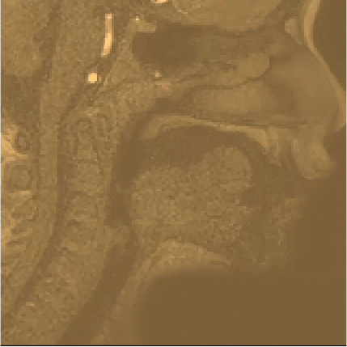
Introduction
¹J. Preston et al., J Vis Exp, 2017
²X. Zhou et al., J Acoust Soc Am, 2008
³B. E. Treeby & B. Cox, J Biomed Opt, 2010
Ultrasound imaging provides tongue shape information
Due to air-tissue interface at tongue surface
Useful for understanding typical and disordered tongue articulation (e.g., for speech therapy) ¹
Anterior tongue tip may be obscured by shadowing
From the sublingual air space and/or mandible bone
Amount obscured not investigated thoroughly
Magnetic resonance imaging (MRI) shows vocal tract
Hypothesis: Numerical simulations using the k-Wave toolbox³ and segmented tissue maps from MRI can efficiently generate midsagittal B-mode images:
Replicate features in measured B-mode images
Recover tongue tip from reverberation artifacts
Fig. 1
Inferior -> Superior
Posterior -> Anterior
Introduction | 2/12
Notes:
(After MRI) Interest in the cross-distance of air which the tongue surface gives information about, and missing tongue tip can be important.
With simulations, we know what the tongue tip is and can evaluate if it is obscured by the shadowing.

Slide 3
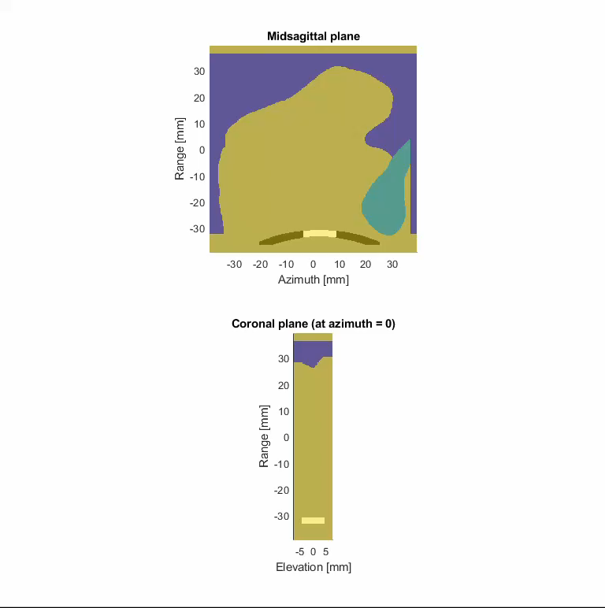
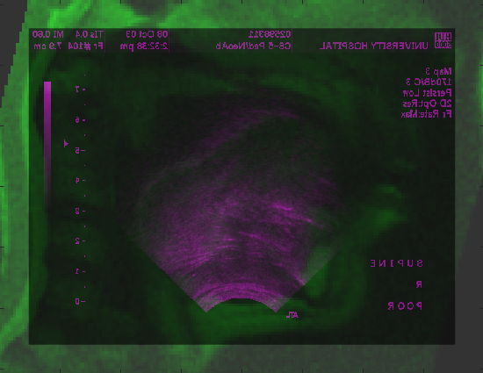
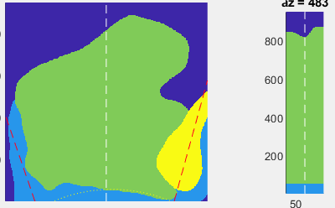
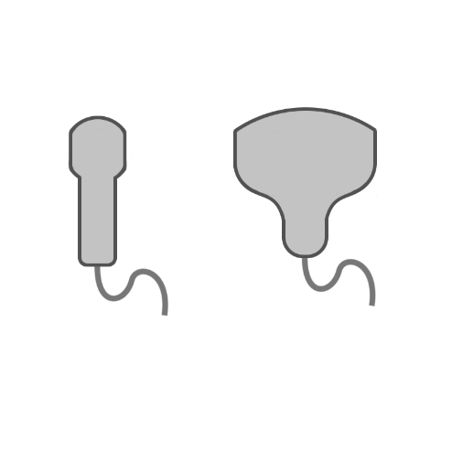
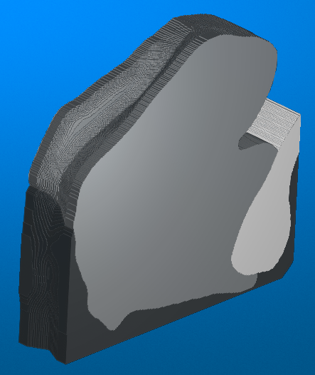
Methods: Data
Step 4
Map: Coronal (top left) and sagittal (top right) planes
Fig. 2
Step 1
Step 2
Step 3
Speakers: 23 speakers, the American English /r/ phoneme
Stimuli and image parameters:
MRI (for tongue tissue maps): supine position; 3-5 mm slice width
Measured ultrasound (for validating simulated ultrasound): supine or upright position; varying imaging parameters: curvilinear probes C5-2, C7-4, C8-5 on HDI 5000 or C6-2 (center frequency 4 MHz) on Siemens Acuson X300
Methods | 3/12
Notes:
/s/: Place tongue properly in vocal tract and use lips to create turbulent air with energy at the right frequencies (> 4.5 kHz)

Slide 4
General simulation parameters
Table 2: Final simulation parameters
Table 1: Transducer model
A linear, fluid (compressional-wave) simulation of acoustic wave propagation in 3D with attenuation was performed in k-Wave.
Transmit/receive apodization | Hanning
Active elements | 27 of 192
Element pitch (mm) | 0.385
Element length (cm) | 1.1
Azimuthal focal depth (cm) | 4
Grid step size, dx (mm) | 0.154
Points per wavelength (PPW, for soft tissue at 4MHz) | 2.6
Courant-Friedrichs-Lewy (CFL) number | 0.26
ª Based on attenuation power law exponent, y of 1.032
^{b} Tongue tissue additionally has scatterers added from a random distribution.
^{c,d} See following slides
Table 3: Final acoustic properties^{4,5} for media used in grid
Medium | Speed of sound (m/s) | Density (kg/m³) | Attenuation (Np/m) at 4 MHzª
Soft tissue (including tongue muscle) | 1588.4^{b} | 1090^{b} | 12.13
Air (at 35°C) | 351.9 | 90^{c} | 12.13
Bone and teeth | 925^{d} | 1090^{d} | 1444
⁴T. L. Szabo, Diagnostic Ultrasound Imaging: Inside Out, 2014
⁵P. A. Hasgall et al., “IT’IS Database”, 2022
Methods | 4/12

Slide 5
Air/tissue interface
Table 4: Models for measuring reflection amplitudes at tissue-air interface, from a linear 1D simulation without attenuation
Adjustments to spatial and time steps were made as long as reflection amplitude values remained close to 1.
Lowered PPW: Based on soft tissue (PPW for air: 0.55)
Model | PPW | Density of air (kg/m³) | CFL | Reflection amplitude
Realistic | 500 | 1.15 | 0.03 | 0.9995
Lowered PPW | 2.5 | 1.15 | 0.03 | 0.8538
Final model | 2.5 | 90 | 0.3 | 0.9556
Final model: Avoided computational instability at higher CFL numbers
Instability possibly associated with large air/tissue impedance mismatch
Increasing the air density allowed stability at higher CFL (larger time steps).
Methods | 5/12

Slide 6
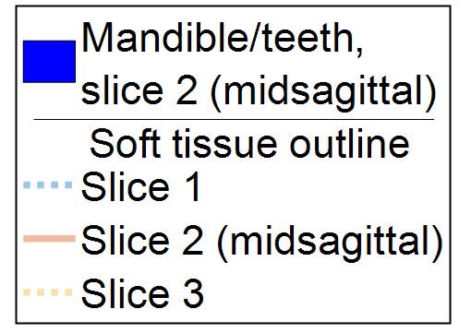
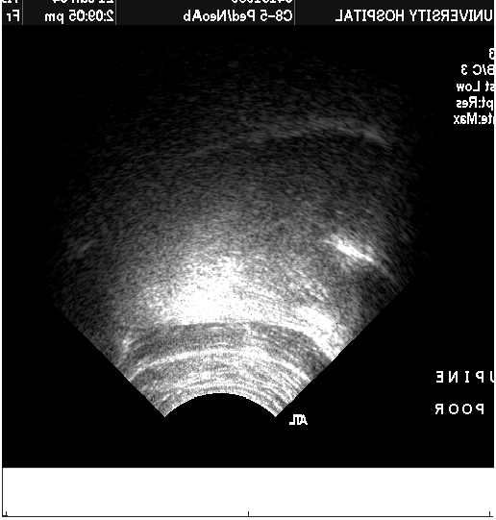
Replicating the bone shadow
Artifact: reflection from mandible
(A)
(B)
Unrealistic reflections from mandible resulted from (A) realistic compressional-wave bone properties and (B) dispersion effects
Fig. 3
(C)
(D)
Table 5: Models for testing bone parameters
Model (fluid) | Speed of sound (m/s) | Density (kg/m³) | Attenuation (Np/m) at 4 MHzª
Realistic¹ | 3198 | 1990 | 170
(B) Matching soft tissue | 1588.4 | 1090 | 722
(C) Final model | 925 | 1090 | 1444
Measured Ultrasound
Methods | 6/12

Slide 7
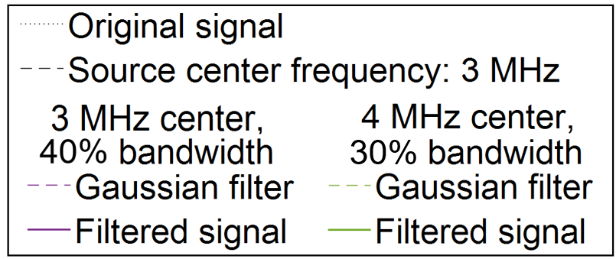
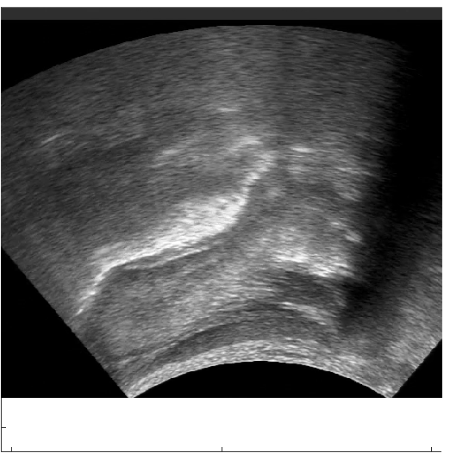
Post-process filtering
Avoids aliasing above ~5 MHz
Measured Ultrasound
(A)
(B)
(C)
Fig. 4: Frequency spectrum
Fig. 5: Simulated images from bandpass-filtered (Fig. 3) scan lines, Gaussian centered at
(A) 3 MHz and (B) 4 MHz. Final image used (B) was more similar to (C), measured ultrasound
Methods | 7/12

Slide 8
Results
Simulated ultrasound images can replicate shadowing and artifacts in measured ultrasound images.
Computational efficiency:
Table 6: Total computation times; maps are cropped to tongue size.
 | Smallest tongue / map | Largest tongue / map
Computation time: NVIDIA A100 (40 GB) GPU | 53 s × 35 scan lines = 31 min | 141 s × 51 scan lines = 2 hr
Computation time: NVIDIA RTX2080 Super (8 GB) GPU | 91 s × 35 scan lines = 53 min | 489 s × 51 scan lines = 7 hr
Number of grid points (excluding PML¹) | 388 × 392 × 58 | 602 × 627 × 58
¹ Perfectly matched layer (PML) for absorbing boundaries
Results | 8/12

Slide 9
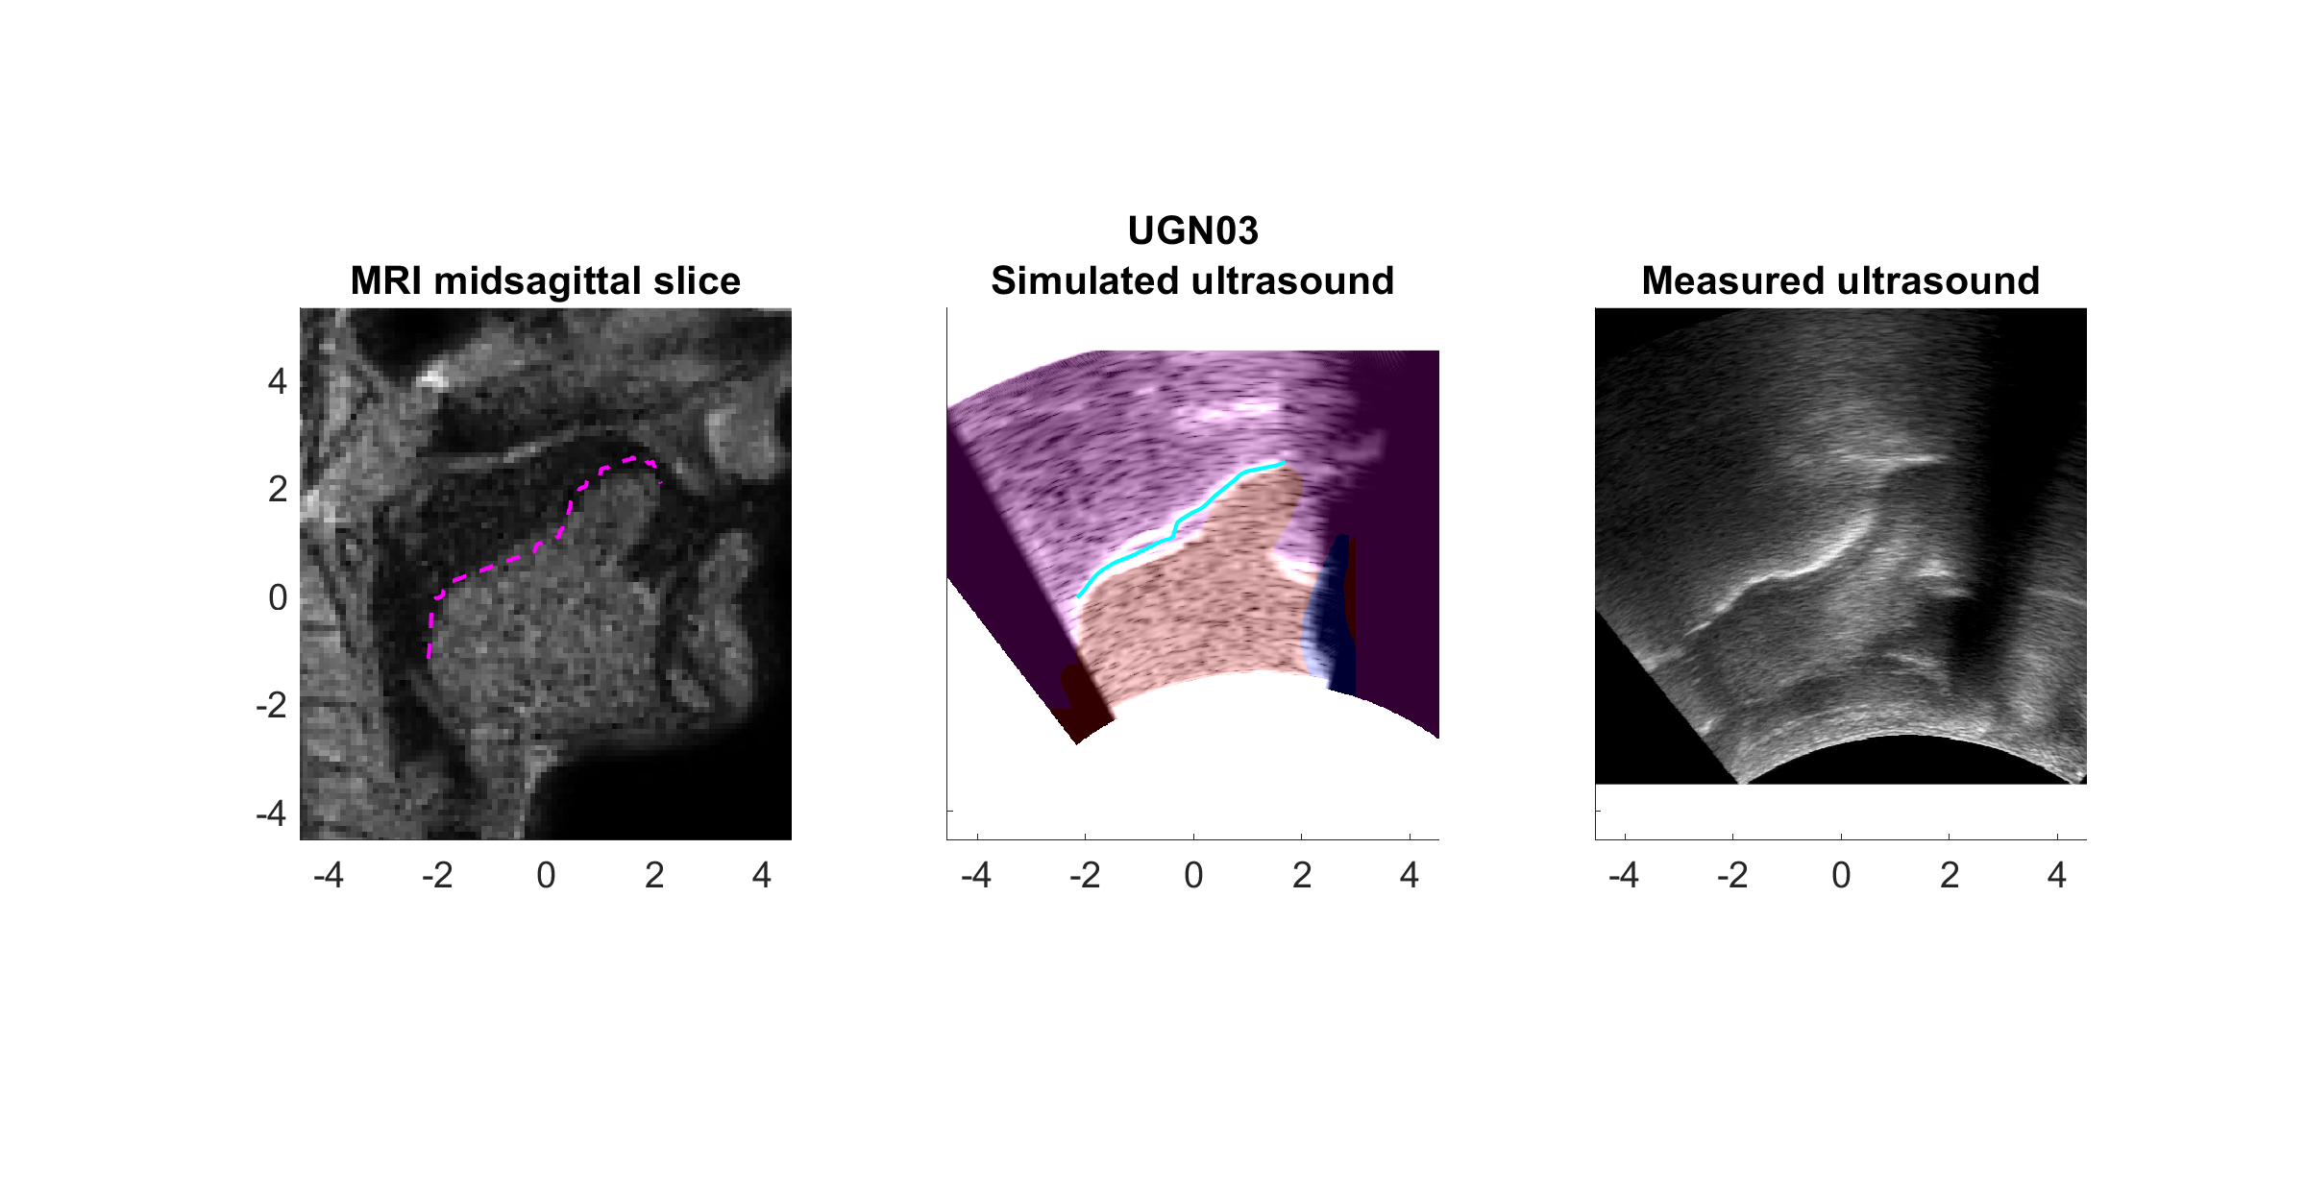
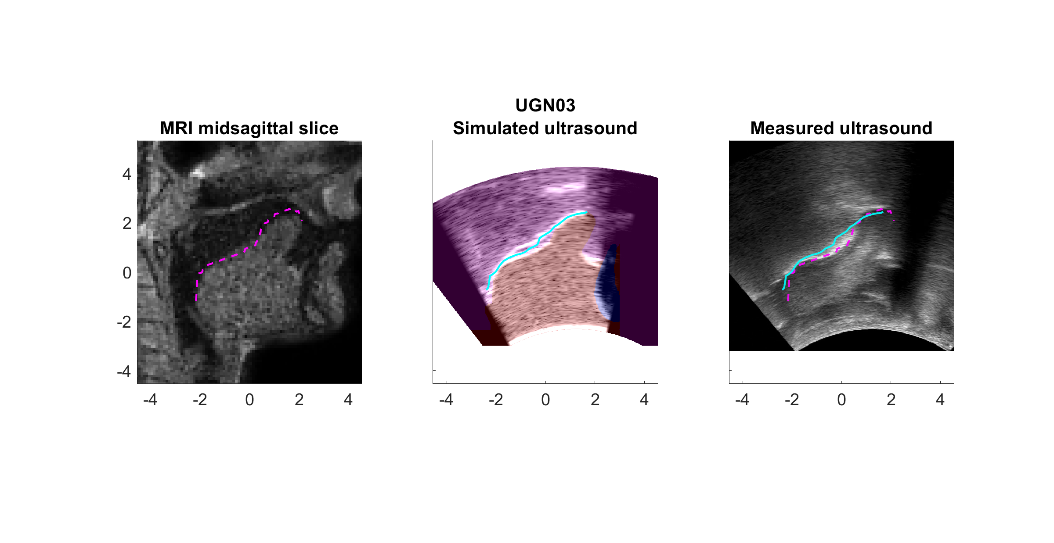
Discussion: Reverberation artifacts (1)
Show that tongue tip thickness (yellow dotted line) is apparent.
Similar to distance between artifact and tongue surface
Simulated ultrasound, adjusted tongue shape
Simulated ultrasound
Fig. 6: Example reverberation artifact #1
Discussion | 9/12

Slide 10
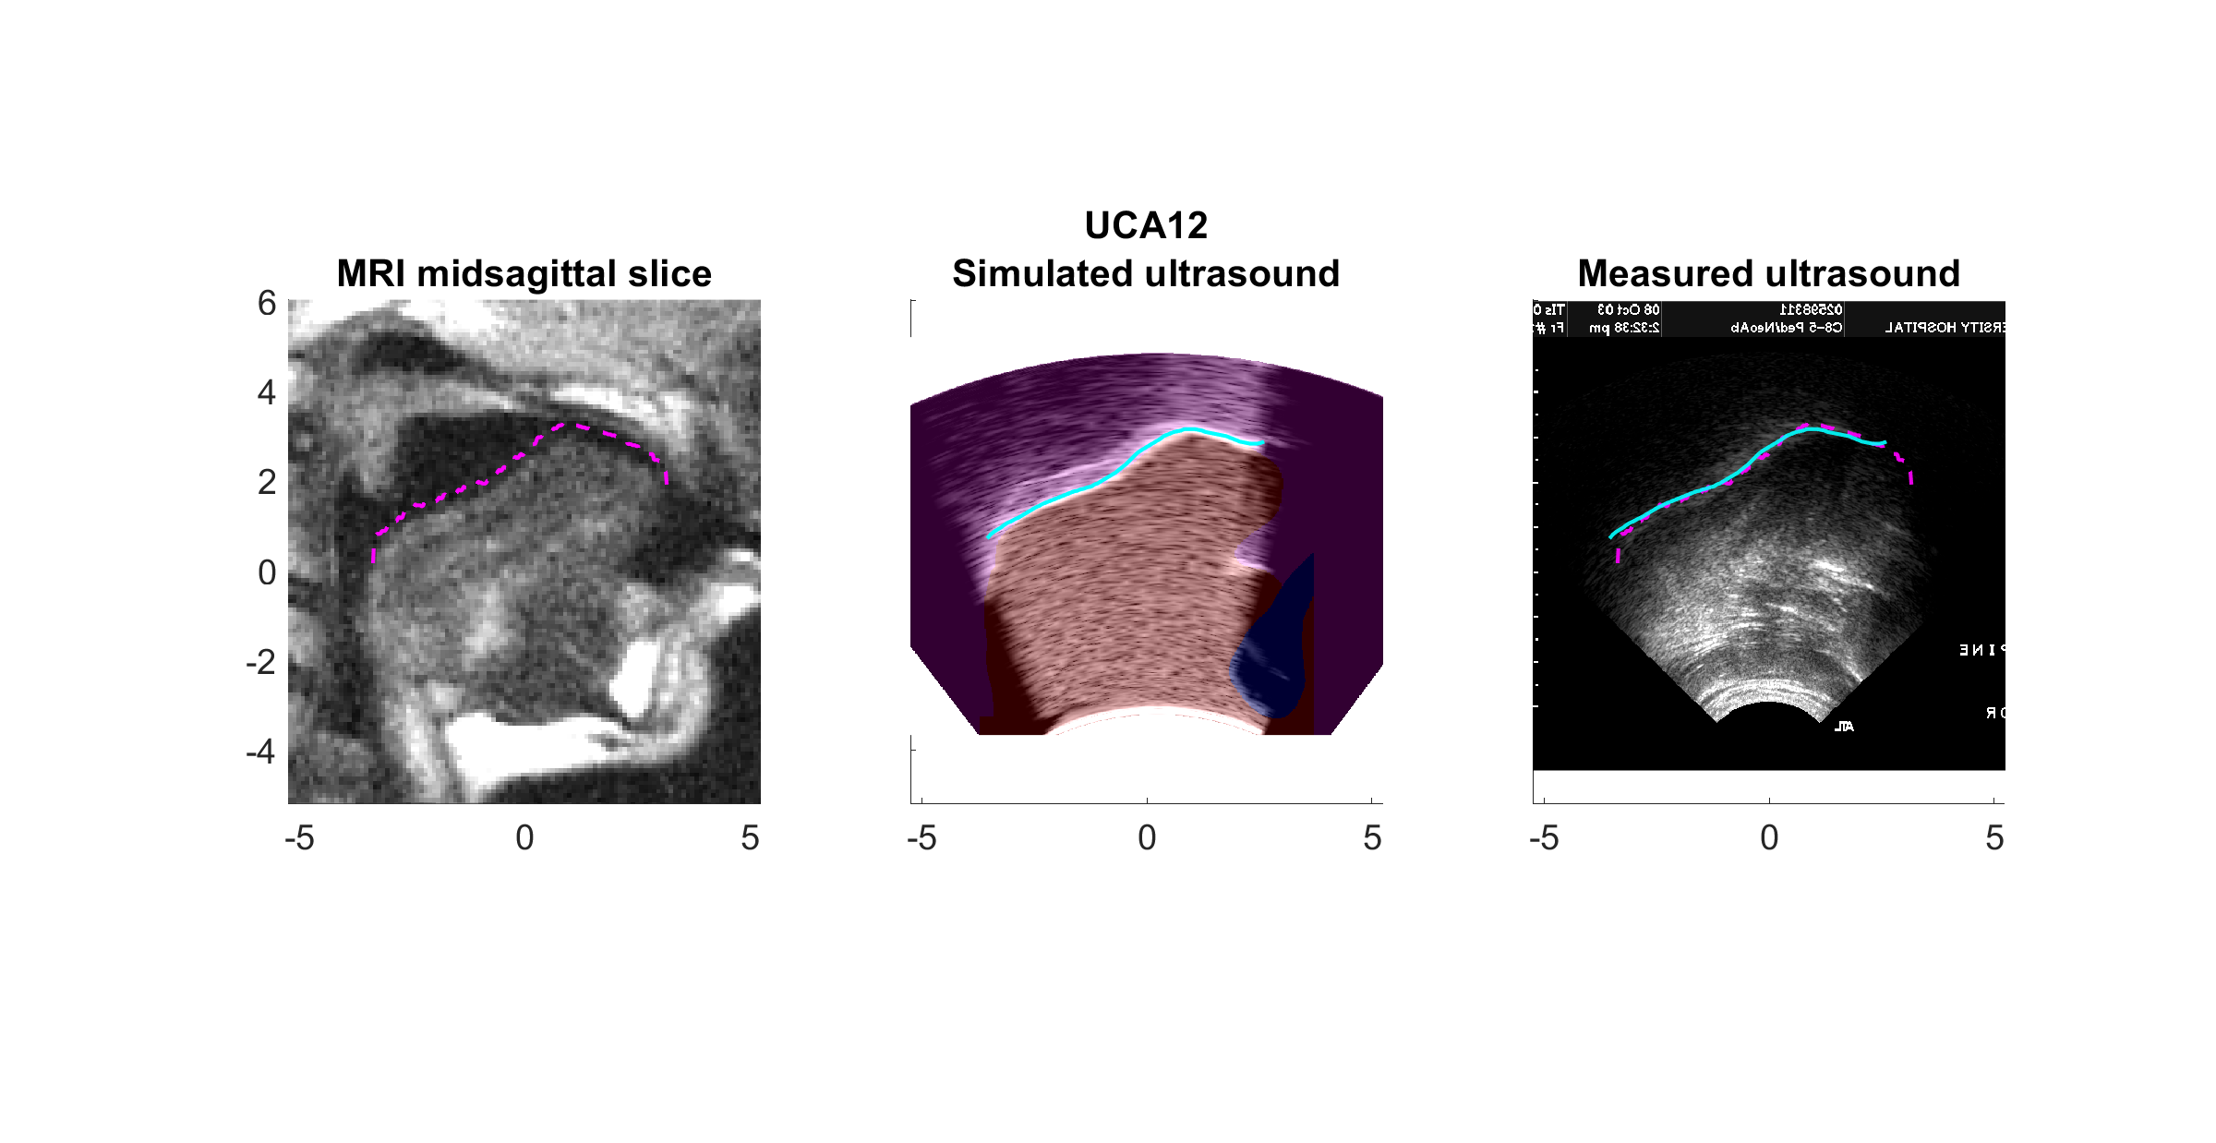
Discussion: Reverberation artifacts (2)
Tongue tip position within the shadow may not be apparent.
Still, may be enough to categorize tongue shapes (see 5aSC37): less tongue tip thickness implies a retroflex /r/ vs. a bunched /r/ shape.
Some artifacts not seen in measured images
Simulated ultrasound, adjusted tongue shape
Simulated ultrasound
Fig. 7: Example reverberation artifact #2
Discussion | 10/12

Slide 11
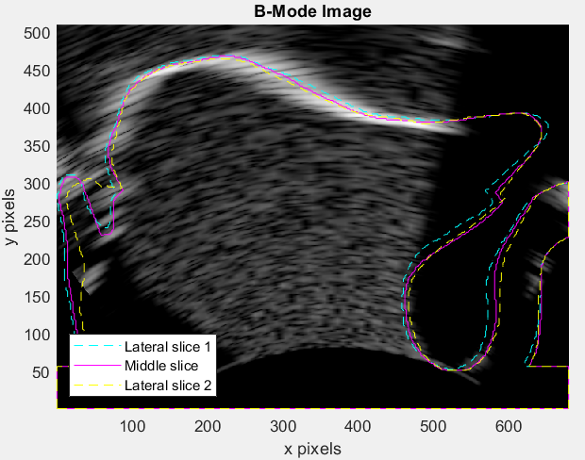
Future work
Adjust bone parameters to better match measured reflection
To understand visibility of tongue tip for the /l/ phoneme
Decrease PML size, which was large (varied for each map, mean of 36 grid points) to decrease computation time
Use simulated maps from 3D MRI to understand double-edge artifact (i.e., groove in tongue causes two apparent contours)
Fig. 8: Soft tissue outline of simulated image for /l/
Future work | 11/12

Slide 12
Acknowledgements
Funding: NIH/NIDCD grants F31 DC020672, R01 DC05250, 8 UL1 TR000077-05, R01 DC013668, and R01 DC017301
Additional mentors Dr. Steven Lulich and Dr. Shrikanth Narayanan for discussions on research project, as well as Dr. Maureen Stone for discussion on initial project idea
Members of Biomedical Acoustics Laboratory led by T. Doug Mast, PhD and the Acoustical Society of America student chapter at University of Cincinnati
Siemens Medical Solutions (for lending Acuson X300 ultrasound scanner)
Acknowledgements | 12/12

Slide 14
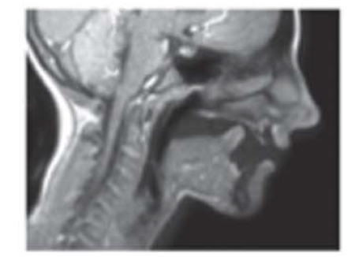
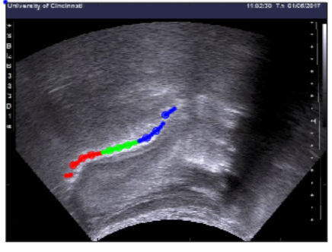
Ultrasound limitations
MRI
Double edge artifacts
Missing one side of the vocal tract
Potentially missing tongue tip
All of these are shown in magnetic resonance imaging (MRI)
To have insight, we can compare ultrasound images and MRI
However, speech is highly variable
→ Numerical simulations
k-Wave toolbox: Open-source MATLAB toolbox using k-space pseudospectral method to simulate propagating acoustic waves
Ultrasound image (same speaker), with visible tongue surface traced as red (tongue root), green (tongue dorsum), and blue (tongue blade)

Slide 15
Research summary
Use simulation of ultrasound waves to recreate ultrasound images from tissue maps segmented from MRI
Determine the extent of different artifacts (reverse engineering to improve interpretation of ultrasound images)
Because tissue maps comprise ground truth, we can be certain that characteristics of the simulated ultrasound images result from specific tissue geometries.
Develop models that can predict missing articulatory information
Characterizations and images from #1 will then be used in conjunction with audio as training data
Deep learning methods to predict articulatory information

Slide 16
Specific Aims
Aim 1: Characterize tongue surface information obscured in ultrasound imaging.
(1a) Develop simulations of ultrasound images based on geometry segmented from MRI.
(1b) Test validity of guidelines for interpreting double edge artifacts.
(1c) Characterize extent of tongue tip information obscured by air in sublingual space.
Aim 2: Predict expanded articulatory information from ultrasound imaging and recorded audio.

Slide 17
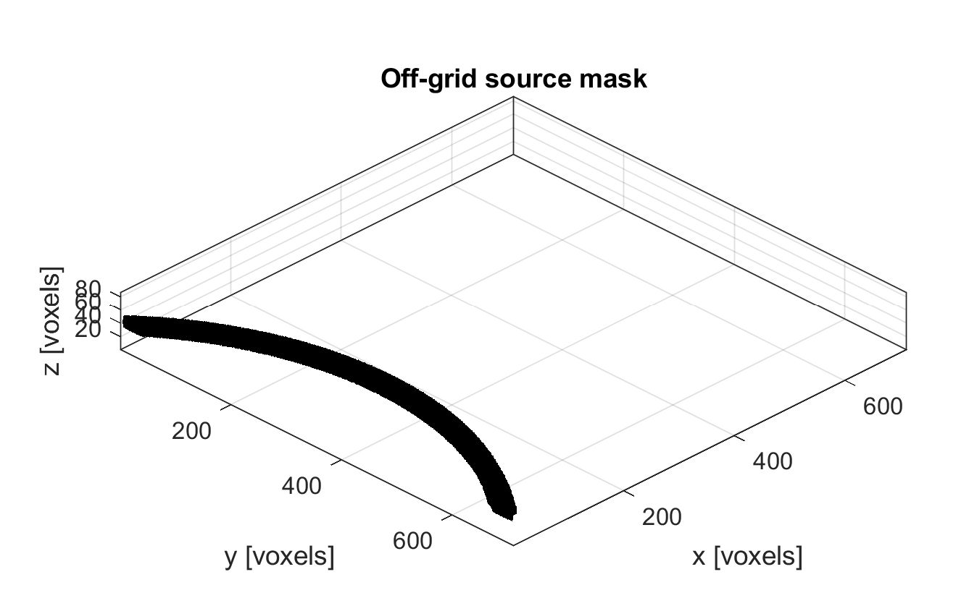
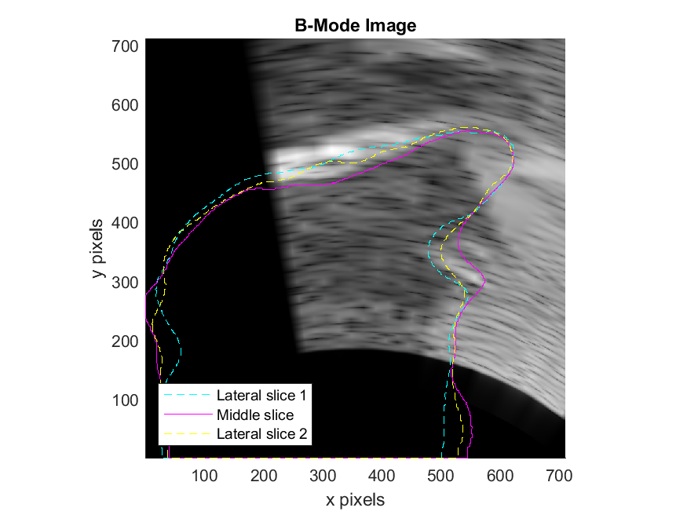
Curved linear array
30 cm focal depth
Element width | 0.2 mm
Element pitch (width plus kerf) | ~0.364 mm
Element length (elevation height) | 1 mm
Radius of curvature | 55.3 mm
Focal length of the lens (elevation focus) | Inf
Number of active elements (aperture size) | 48 of 192
Transmit/receive apodization | Rectangular
Number of cycles in the ultrasound pulse (or bandwidth) | 4
Notes:
Note: have been using 49 active elements of 196 elements

Slide 18
Curved linear array
Distance between points: 0.00036395 [m]

Slide 19
Introduction
¹J. Preston et al., J Vis Exp, 2017
²X. Zhou et al., J Acoust Soc Am, 2008
³B. E. Treeby & B. Cox, J Biomed Opt, 2010
Ultrasound imaging provides tongue shape information
Due to air-tissue interface at tongue surface
Useful for understanding typical and disordered tongue articulation (e.g., for speech therapy) ¹
Anterior tongue tip may be obscured by shadowing
From the sublingual air space and/or mandible bone
Amount obscured not investigated thoroughly
Magnetic resonance imaging (MRI) shows vocal tract
Hypothesis: Numerical simulations using the k-Wave toolbox³ and segmented tissue maps from MRI can efficiently generate midsagittal B-mode images:
Replicate features in measured B-mode images
Recover tongue tip from reverberation artifacts
Inferior -> Superior
Posterior -> Anterior

